Slide 1
TEMPO Data Distribution at The Atmospheric Science Data Center
Hazem Mahmoud, Ph.D.​
ASDC Scientist​
Notes:
STILL

Slide 2
ASDC Overview
TEMPO Data Distribution
Tools and Services for TEMPO
ASDC in the Cloud

Slide 3
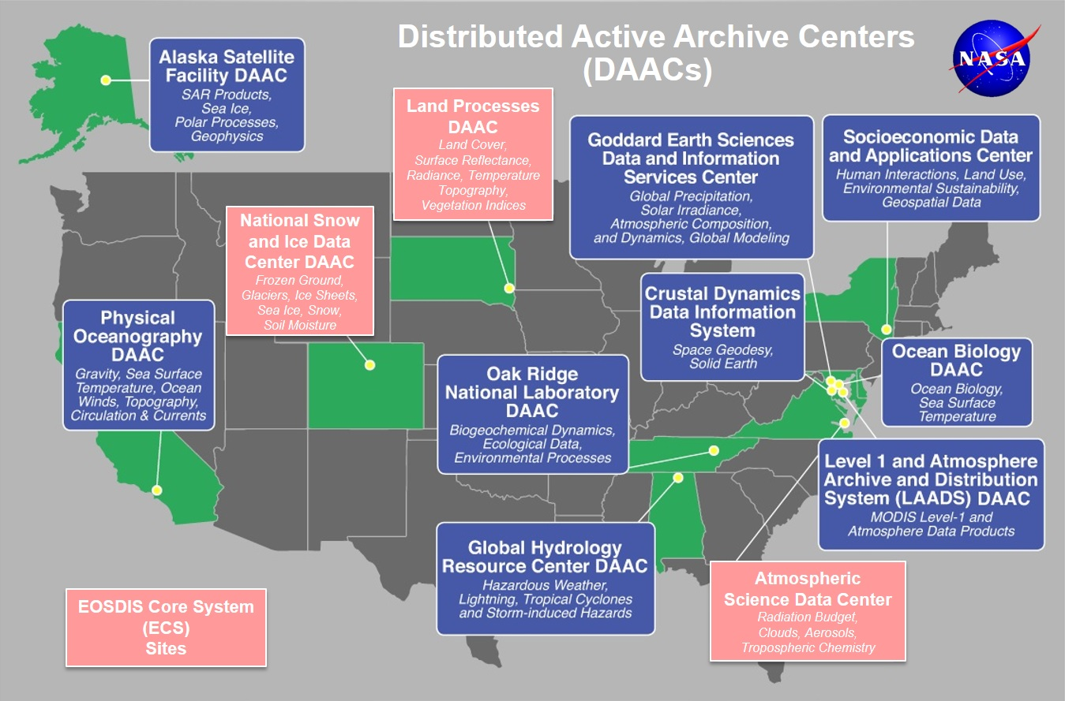
Earth Observing System Data and Information System EOSDIS
EOSDIS data centers process, archive, and distribute thousands of data products to the global user community. The primary services provided by EOSDIS are data archive & management, distribution, information management, product generation, and user support. It is comprised of multiple components including:
Distributed Active Archive Centers (DAACs)
Science Data Processing Segment (SDPS)
Science Investigator-led Processing Systems (SIPS)
Common Metadata Repository (CMR)
Earth Data Search (EDS)
Global Imagery Browse Services (GIBS)
more

Slide 4

ASDC Vision
"To be a leading provider of atmospheric science data products and services to the science community through agility, innovation, and technical excellence“

Slide 5
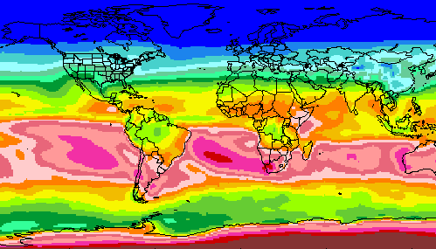
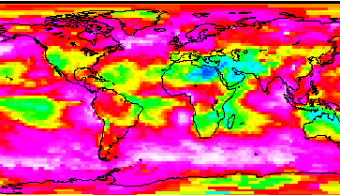
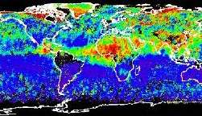
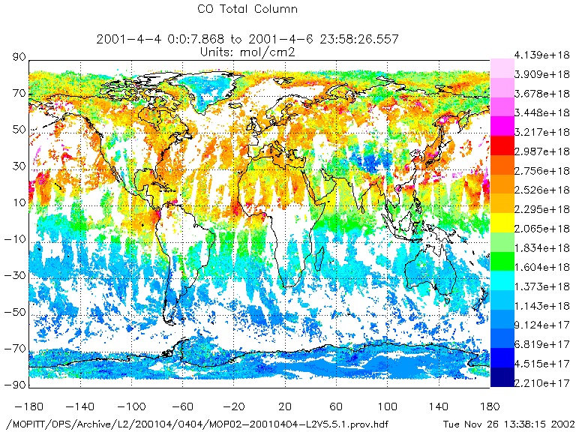
RADIATION BUDGET
CLOUDS
ASDC at a glance
44+ Science projects
⚬ MISR ⚬ MOPITT ⚬ MAIA ⚬ TEMPO ⚬ CERES
⚬ CALIPSO ⚬ SAGE ⚬ PREFIRE ⚬ CLARREO-PF ⚬ LIBERA
⚬ Airborne field campaigns (KORUS AQ, DISCOVER AQ, FIREX AQ, TOLNET)
1100+ unique science products
Data usage
⚬ 2,061 Terabytes ⚬ 160,000 users
⚬ 158 countries
Data archive
⚬ 5.8 Petabytes ⚬ 141 million files (4,400 TB) on high-speed disks
Data in cloud (ongoing)
⚬ Data and services in the cloud
⚬ Scalable infrastructure
AEROSOLS
TROPOSPHERIC COMPOSITION
Primary Functions of ASDC
Ingest receive data from data provider
Archive preservation & provenance
Distribute tools and services
Process create higher level products
Outreach & Support research community

Slide 6
Services at the ASDC
PRE-LAUNCH
Preparation for Ingest
Accurate metadata for discovery
Well formatted data for maximum interoperability
Digital Object Identifiers for each product
Support Data Flow Testing Prior to Launch
Interface confidence tests
End-to-end ground system testing with instrument or synthetic data
Discuss Service Options
Customer/Product affinities and technical capacity
Data Delivery Cadence
ACTIVE OPERATIONS
Standard curation of archived data
Provenance and integrity
Up to date documentation
Disaster Recovery
User Services staff to assist customers
Maintain FAQs, examples of scripts
Perform reach back to science team when necessary
Disseminate announcements to user community
Use customer feedback from annual third-party ACSI survey, contacts, and ASDC User Working Group to determine changes in services
Subsetting and ArcGIS capabilities
Temporal, spatial and variable slices

Slide 7
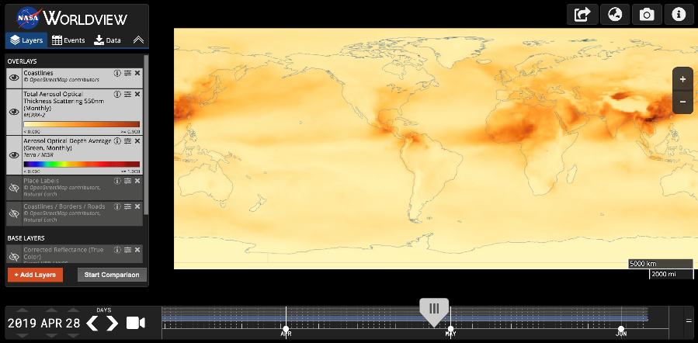





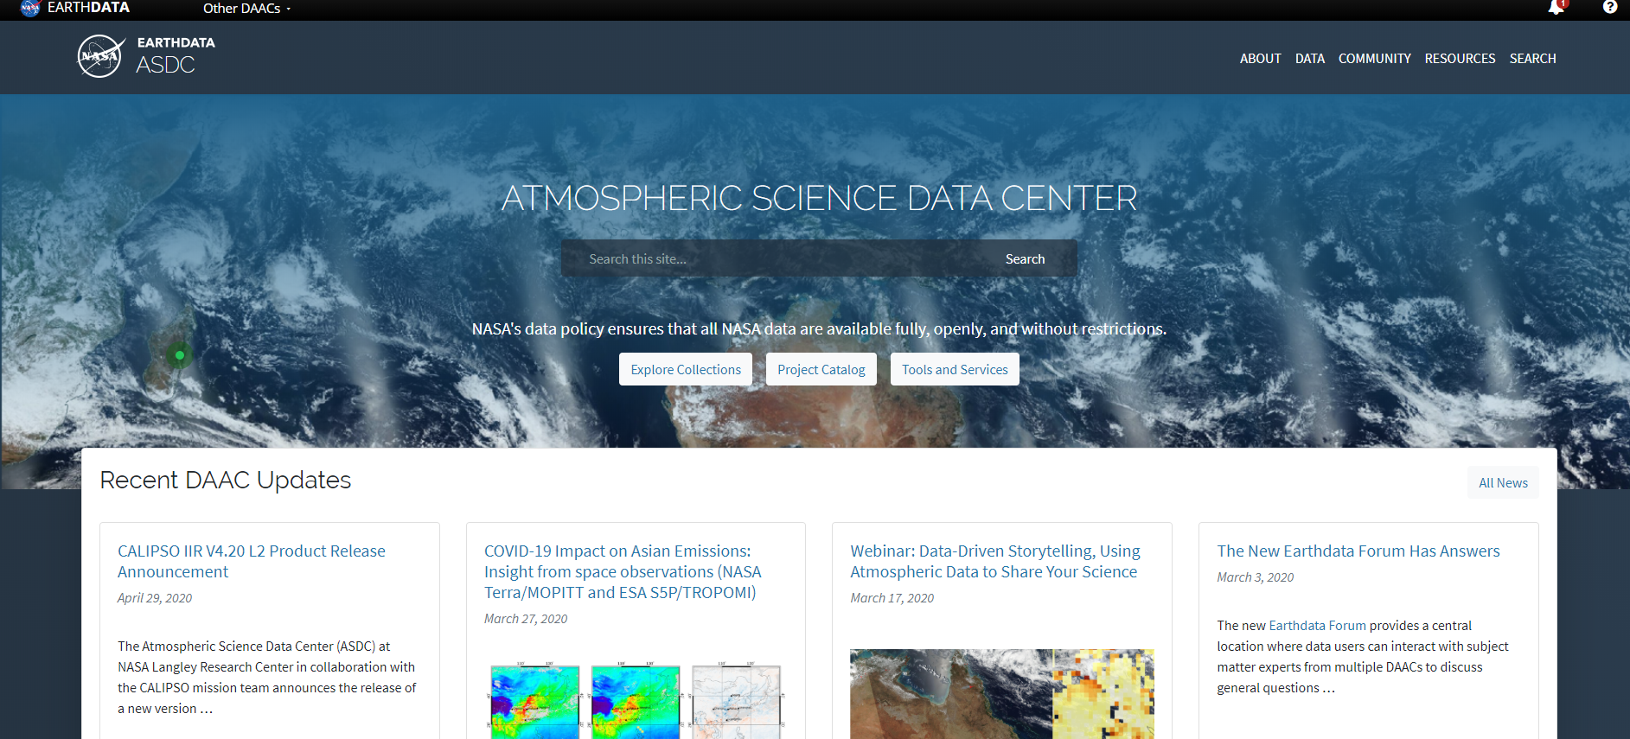
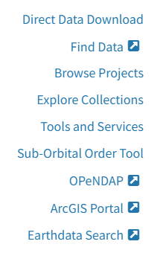



ASDC Data Distribution: Tools and Services
NASA Earthdata Search
⚬ metadata ⚬ browse ⚬ download ⚬ customize ⚬ HTTPS and AWS S3 direct data access
NASA Earthdata WorldView
⚬ visualize ⚬ GIBS API
NASA Earthdata Harmony
⚬ transform ⚬ subset ⚬ reformat
NASA Earthdata GIS
⚬ ArcGIS Image & Feature Service ⚬ OGC WMS, WFS & WCS
OPeNDAP
⚬ transform ⚬ subset ⚬ reformat
ASDC Subsetters
⚬ subset ⚬ aggregate
User Support and Other Resources
Example scripts
⚬ Python/Jupyter Notebook ⚬ R scripts
⚬ contributed tutorials/scripts
Earthdata Forum https://forum.earthdata.nasa.gov/
ASDC User Support support-asdc@earthdata.nasa.gov
https://asdc.larc.nasa.gov/
Notes:
Earthdata Login https://urs.earthdata.nasa.gov

Slide 8
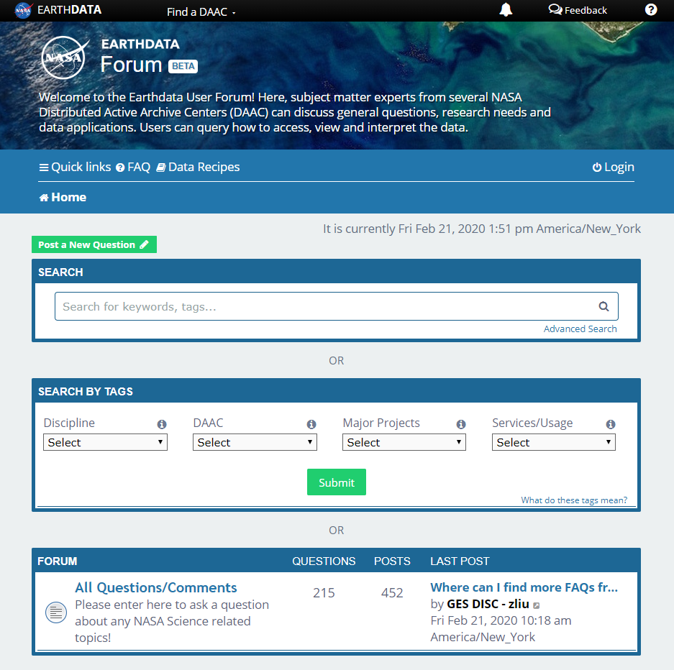
Earthdata Forum
Science Data Users can seamlessly search for information even if they do not know which DAAC the data belongs to.
Scientists & Data Providers can effectively assist their user community in more accurately using their products.
DAACs & Subject Matter Experts (SMEs) can quickly link users to existing resources.
DAAC User Services can swiftly provide inquirers with an authoritative source related to DAAC data products & services.
https://forum.earthdata.nasa.gov/
Notes:
The Earthdata Forum is our new online resource for staff members and subject matter experts from several NASA Distributed Active Archive Centers (DAACs) assist inquirers with questions about their NASA Earth science data. General questions, research needs, and data applications can all be subjects here. Members of the NASA scientific user community are encouraged also provide insights and collaborative assistance.​

Slide 9
Atmospheric Science Data Center
NASA Langley Research Center
Hampton, Virginia (USA)
https://asdc.larc.nasa.gov/
support-asdc@earthdata.nasa.gov

